Slide 1
JavaScript
(Advanced Part 1)

Slide 2
JS Advanced – Part 1
Lexical Environment (where code is written)
Hoisting (the two phases of JS execution)
Execution Context (the ”instance” of an environment a piece of code is executing within)
Scope Chain (the ”outer” environment for a piece of executing code)

Slide 3
JS Advanced – Part 1
Lexical Environment (where code is written)
Concerned with the physical position of code
Outermost level is the global environment
Global = ”not inside a function” (or class)
[CODE]

Slide 4
JS Advanced – Part 1
Hoisting
Execution of JS is a two-phase operation:
Creation phase: set up memory space for variables, functions, etc.. No execution of code, nor initialisation of variables! All variables will be set to undefined.
Execution phase: the code is actually executed.
”Hoisting” is what happens in the creation phase.
[CODE]

Slide 5
JS Advanced – Part 1
Execution phase: the code is actually executed
Variables: values are assigned
Function invocation: more complicated…
Whenever a function is called (invoked), a new execution context is created.
Execution contexts are ”dynamic”, i.e. created at run-time.
Execution context != lexical environment

Slide 6
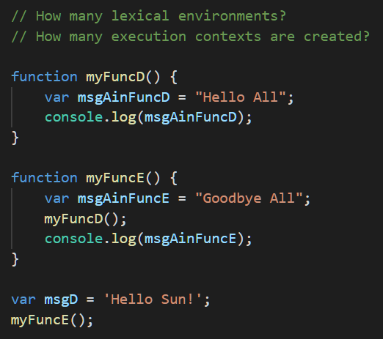

Slide 7
Execution Stack
Global Ex. Cont.
myFuncD
myFuncE
msgD

Slide 8
myFuncE() Ex. Cont.
Execution Stack
msgAinFuncE
Global Ex. Cont.
myFuncD
myFuncE
msgD

Slide 9
myFuncD() Ex. Cont.
msgAinFuncD
myFuncE() Ex. Cont.
Execution Stack
msgAinFuncE
Global Ex. Cont.
myFuncD
myFuncE
msgD

Slide 10
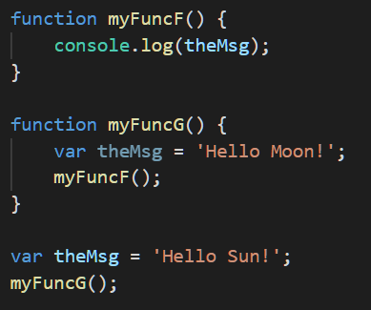
myFuncF() Ex. Cont.
myFuncG() Ex. Cont.
theMsg
Global Ex. Cont.
myFuncF
myFuncG
theMsg

Slide 11
Global Lex. Env.
Global Ex. Cont.
myFuncF Lex. Env.
myFuncG() Ex. Cont.
myFuncG Lex. Env.
myFuncF() Ex. Cont.

Slide 12
Global Lex. Env.
Global Ex. Cont.
Exec.
stack
myFuncF Lex. Env.
myFuncG() Ex. Cont.
myFuncG Lex. Env.
myFuncF() Ex. Cont.
Outer
Environ-ment

Slide 13
Global Lex. Env.
Global Ex. Cont.
myFuncF
myFuncG
theMsg
myFuncF
myFuncG
theMsg
myFuncF Lex. Env.
myFuncG() Ex. Cont.
theMsg
myFuncG Lex. Env.
myFuncF() Ex. Cont.
theMsg
Scope
Chain

Slide 14
JS Advanced – Part 1
When a variable is not in the local execution context, JS looks in the ”outer environment”
”outer environment” is a reference to the execution context corresponding to the lexical outer environment.
This is called following the Scope Chain

