Slide 1
JavaScript
(Advanced Part 2)

Slide 2
JS Advanced – Part 2
What are objects?
Constructer functions
Prototypical inheritance
ES6 object construction (classes)

Slide 3
JS Advanced – Part 2
What are objects?
Objects are (just) a collection of name/value pairs
A value may be
Of a simple type (string, number,…)
A function definition
An object (hello, recursion!)

Slide 4
JS Advanced – Part 2

Slide 5
JS Advanced – Part 2
Object literals: simple, but repetitive
OK for properties (values are individual)
Bad for functions (same for all objects of same type)
How can we ”build” objects from a definition?
Constructor functions
Prototypical inheritance
Class definitions (ES6)

Slide 6
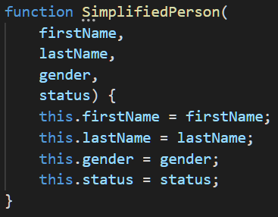
JS Advanced – Part 2
Constructor functions
Remember: FUNCTIONS ARE OBJECTS!
Syntax: function nameOfType (…) {}
Use of constructor function:
var sp = new SimplifiedPerson(…);

Slide 7
JS Advanced – Part 2
Constructor functions – fine wrt. properties, but still problem with functions
Adding functions directly to objects: works, but again repetitive [CODE]
Adding functions to prototype: better ☺ [CODE]

Slide 8
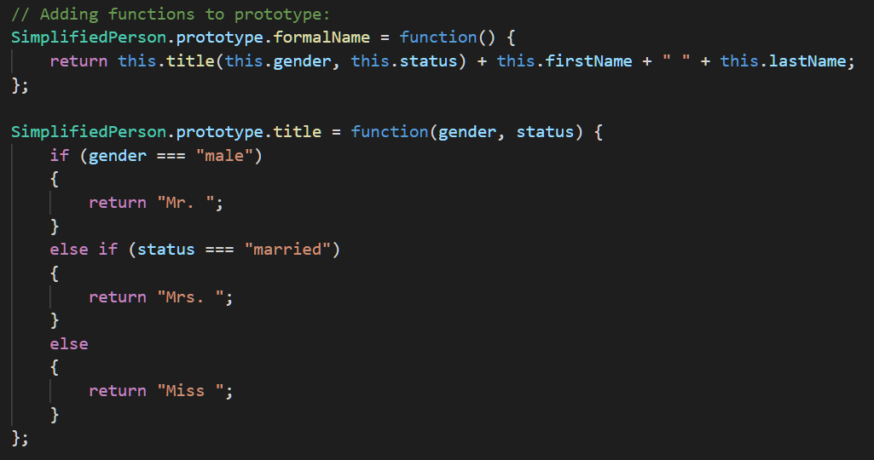
JS Advanced – Part 2

Slide 9
JS Advanced – Part 2
Now SimplifiedPerson is (almost) like a class definition
Constructor function for setting object-specific property values
Functions added to SimplifiedPerson prototype, thereby available to all objects of ”type” SimplifiedPerson
But what about inheritance…?
Person = SimplifiedPerson + address properties. How…?

Slide 10
JS Advanced – Part 2
JS offers prototypical inheritance
Slightly convoluted…
Create constructor function for ”derived” type (Person)
Inside the new constructor function, call the ”base” constructor function (SimplifiedPerson.call(this,…))
Do usual initialisation of properties in derived type
AFTER the constructor function, set prototype of derived type to refer to prototype of base type, using Object.create(…)
[CODE]

Slide 11
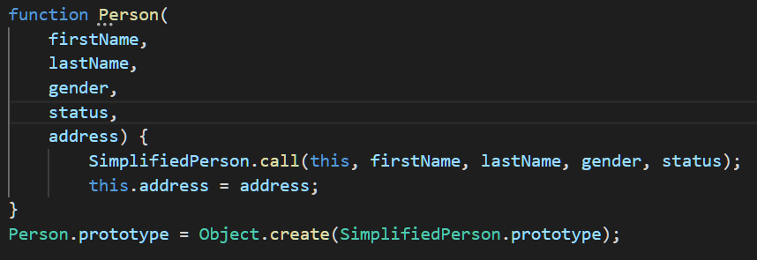
JS Advanced – Part 2

Slide 12
JS Advanced – Part 2

Slide 13
JS Advanced – Part 2
ES6/2015 now offers the class keyword (also the extends keyword)
Class definitions are now (syntactically) closer to e.g. class defintions in C#
NB: only ”syntactic sugar” – nothing has changed under the covers…

Slide 14
JS Advanced – Part 2
ES6 class definition
Uses class keyword
Function constructor marked with constructor keyword
No explicit properties – properties are typically added in the function constructor
Methods added inside class definition, syntax is nameOfMethod(…parameter list…) { body}

Slide 15
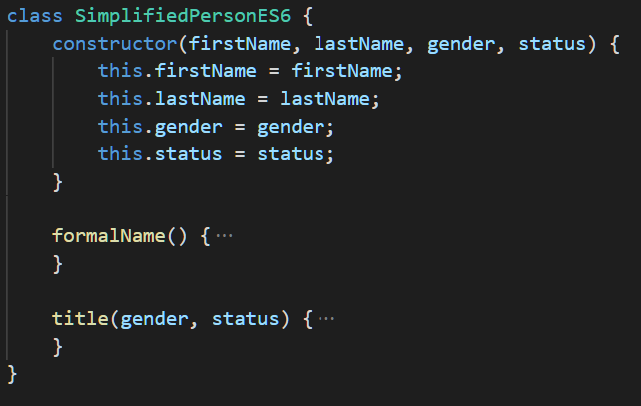
JS Advanced – Part 2

Slide 16
JS Advanced – Part 2
ES6 class definition
Inheritance by use of extends keyword
Constructor will typically call ”super class” constructor, using the super keyword
Prototype references are automatically set up

Slide 17
JS Advanced – Part 2

Slide 18
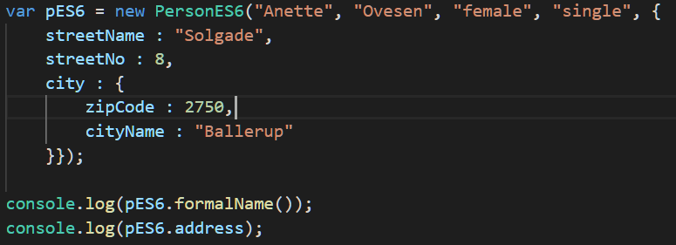
JS Advanced – Part 2

Slide 19
Typical base/derived class scenario
Base class contains X properties…
…so base class constructor typically takes X parameters, to initialise these X properties
Derived class contains Y properties…
…so derived class constructor typically takes X + Y parameters, to initialise own and base class properties, like this:
X of these parameters are used to call base class constructor!
Y of these parameters are used for initialising derived class properties.

