Slide 1
JavaScript
(Advanced Part 3)

Slide 2
JS Advanced – Part 3
Array helper/query methods
forEach
map and filter
reduce
find, some and every

Slide 3
JS Advanced – Part 3
The forEach method
Is applied to an array
General syntax: myArray.forEach(callBack)
callBack: A function which is called for each element in the array
Callback takes three parameters:
item: the item currently being processed
index: the index of the above item
array: the array itself

Slide 4
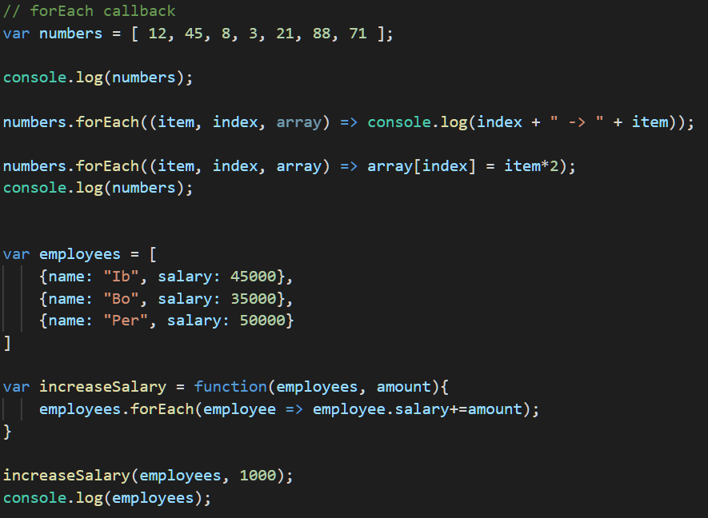
JS Advanced – Part 3

Slide 5
JS Advanced – Part 3
The map method
General syntax: myArray.map(callBack)
callBack: A function which is called for each element in the array, taking the element itself as a parameter
NB: The result of invoking map will be a new array, with the same number of elements as the original array.
Callback is often an anonymous function (=>)

Slide 6
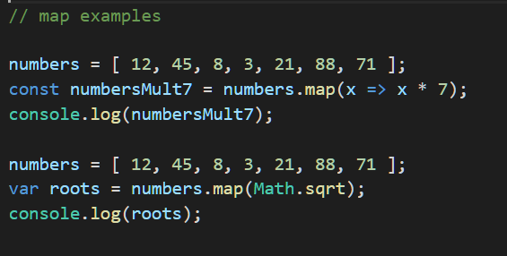
JS Advanced – Part 3

Slide 7
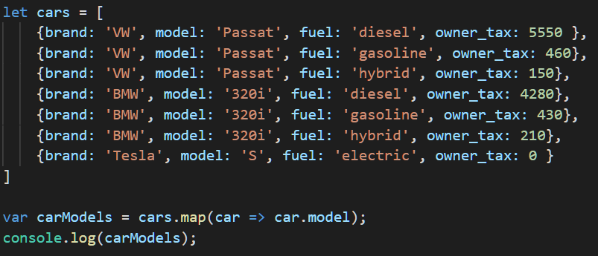
JS Advanced – Part 3

Slide 8
JS Advanced – Part 3
The filter method
General syntax: myArray.filter(callBack)
callBack: A function which is called for each element in the array, taking the element itself as a parameter. This callback must return a boolean value.
NB: The result of invoking filter will be a new array, only including the elements for which the callback returns true
Callback is often an anonymous function (=>)

Slide 9
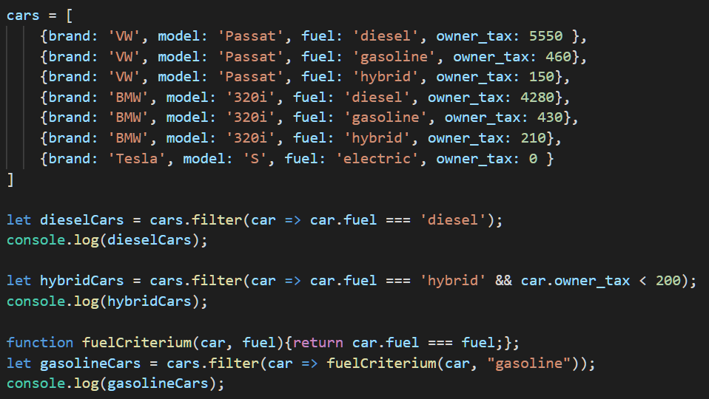
JS Advanced – Part 3

Slide 10
JS Advanced – Part 3
find: returns the first element for which the callback returns true (returns undefined if no element is found)
every: returns true if the callback returns true for all elements in the array.
some: returns true if the callback returns true for at least one element in the array.

Slide 11
JS Advanced – Part 3
The reduce method
General syntax: myArray.reduce(reducerFunc, initialValue)
reducerFunc: A function which is called for each element in the array, taking four parameters:
accumulator
currentValue
currentIndex
sourceArray
initialValue: The initial value to be used by the reducer function, i.e. accumulator is initially set to initialValue.

Slide 12
JS Advanced – Part 3
The reduce method
accumulator: the ”accumulated value” of applying the function so far (i.e. to the previous elements)
currentValue: value for the element being processed right now
currentIndex: index for the above element
sourceArray: reference to the array which we are invoking reduce on.

Slide 13
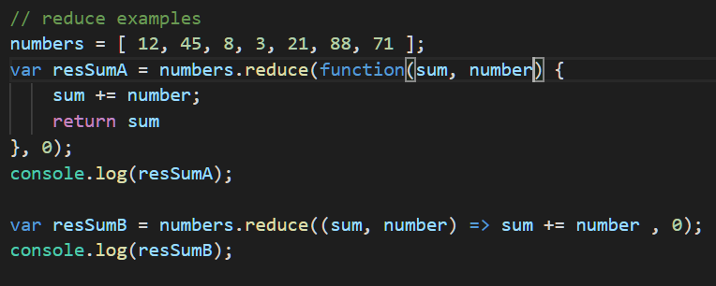
JS Advanced – Part 3

Slide 14
JS Advanced – Part 3

Slide 15
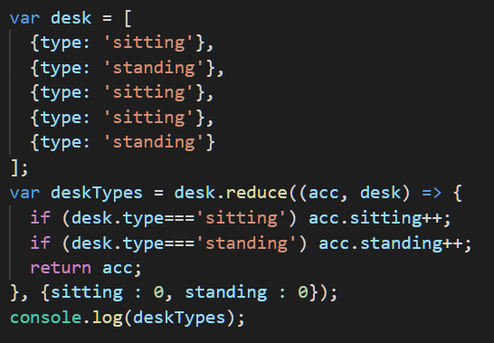
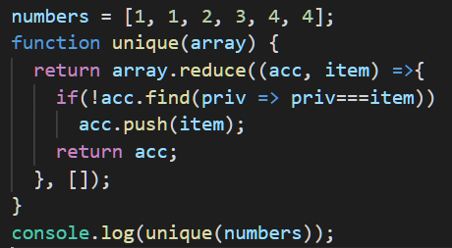
JS Advanced – Part 3

Slide 16
JS Advanced – Part 3
Also see: https://developer.mozilla.org/en-US/docs/Web/JavaScript/Reference/Global_Objects/Array

