Slide 1
JavaScript
(Advanced Part 4)

Slide 2
JS Advanced – Part 4
Closure: The closure is a collection of all the variables in scope at the time of creation of the function.
https://medium.com/dailyjs/i-never-understood-javascript-closures-9663703368e8
Closures mostly get relevant for functions returning functions….

Slide 3
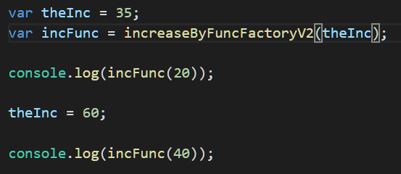
JS Advanced – Part 4

Slide 4
JS Advanced – Part 4
When a function (object) is created, it gets a reference to the closure specific for that function creation.
The closure contains copies of values which were in scope at creation.
This even holds for object references!
The VS Code debugger can show closures at run-time.

Slide 5
JS Advanced – Part 4
var: execution context is global, function scope.
let: execution context is at the block, expression scope.
https://medium.com/front-end-developers/es6-variable-scopes-in-loops-with-closure-9cde7a198744

Slide 6
JS Advanced – Part 5
Remember: JavaScript is synchronous!
The ability for asynchronous execution is ”added” by the environment (browser, node,…)
Four elements involved
Heap
Stack
Event queue
Event loop

Slide 7
JS Advanced – Part 5
Stack
Heap
Callback Queue
Event Loop

Slide 8
JS Advanced – Part 5
Stack
Handles memory management for execution contexts (EC)
When a function is called, an EC is pushed onto the stack
EC contains memory for parameters and locally scoped variables
When function call ends, EC is popped off the stack

Slide 9
JS Advanced – Part 5
Heap
Handles memory management for dynamically allocated objects.
That is; the objects themselves are stored in the heap.
Object references are not stored on the heap.
Since functions are objects, we may also have objects representing function instances in the heap (which may refer to closures ☺)

Slide 10
JS Advanced – Part 5
Callback queue
If e.g. a function call includes a callback, the callback function is placed in the callback queue.
Callbacks can be explicitly written in the code, or may be more implicit (promises, async/await)
How are callbacks ever processed…?

Slide 11
JS Advanced – Part 5
Event loop
The event loop continuously monitors the stack
If the stack is empty – and the callback queue is not empty – the first callback in the event queue is placed on the stack
The callback then gets executed!
NB: No guarantees about when a callback is executed!

Slide 12
JS Advanced – Part 5
A promise is a convenient way to express an operation which may be executed asynchronously.
A promise implementation will end up calling resolve or reject.
A call to a function which returns a promise is usually followed by a call to the then method
Multiple then calls can be chain together!

Slide 13
var promise = new Promise(function(resolve, reject) { // do a thing, possibly async, then… if (/* everything turned out fine */) { resolve("Stuff worked!"); } else { reject(Error("It broke")); } });
promise.then(function(result) { console.log(result); // "Stuff worked!" }, function(err) { console.log(err); // Error: "It broke" });

Slide 14
JS Advanced – Part 5
A call to a function which returns a promise is usually followed by a call to the then method
The then method takes two functions as arguments:
A function for handling resolve
A function for handling reject

Slide 15
function get(url) { // Return a new promise. return new Promise(function(resolve, reject) { // Do the usual XHR stuff var req = new XMLHttpRequest(); req.open('GET', url); req.onload = function() { // This is called even on 404 etc // so check the status if (req.status == 200) { // Resolve the promise with the response text resolve(req.response); } else { // Otherwise reject with the status text // which will hopefully be a meaningful error reject(Error(req.statusText)); } }; // Handle network errors req.onerror = function() { reject(Error("Network Error")); }; // Make the request req.send(); }); }
get('story.json').then(function(response) { console.log("Success!", response); }, function(error) { console.error("Failed!", error); })

Slide 16
JS Advanced – Part 5
NB: When a promise has been returned, the code will proceed to the next statement!
The then method will be called as a callback function.
Enables us to do other stuff, while the promise gets resolved (or rejected)….

Slide 17
JS Advanced – Part 5
async/await: a newer (simpler?) way of expressing the same thing
Suppose f() return a promise:
var data = await f(); // wait here until f is resolved.
NB: The wait does not block the execution – code will continue in the calling function!
If a function contains an await statement, the function must be marked with the async keyword

